Slide 1
Chapter 8: Main Memory

Slide 2
Three/Four Key Components of an OS
1. Process Management
2. Memory Management
3. Storage Management
3.5 I/O Systems

Slide 3
Chapter Objectives
To provide a detailed description of various ways of organizing memory hardware
To discuss various memory-management techniques, including paging and segmentation
To provide a detailed description of the Intel Pentium, which supports both pure segmentation and segmentation with paging

Slide 4
Content Overview
Background
Swapping
Contiguous Memory Allocation
Paging
Structure of the Page Table
Segmentation
Example: The Intel Pentium

Slide 5
Memory Management Requirements
Relocation (重定位)
Memory Protection (存储保护)
Memory Sharing (存储共享)
Logical Organization (逻辑组织)
Physical Organization (物理组织)

Slide 6
Relocation
Programmer does not know where the program will be placed in memory when it is executed.
While the program is executing, it may be swapped to disk and returned to main memory at a different location (relocated).
Memory references(存储引用)must be translated in the code to actual physical memory address.

Slide 7
Relocation
A process may occupy different partitions which means different absolute memory locations during execution (from swapping).
Compaction will also cause a program to occupy a different partition which means different absolute memory locations.

Slide 8
Addresses
Logical
reference to a memory location independent of the current assignment of data to memory.
translation must be made to the physical address.
Relative
address expressed as a location relative to some known point.
Physical
the absolute address or actual location in main memory.

Slide 9

单选题
1分
1. Absolute code can be generated for ____
A
compile-time binding
B
load-time binding
C
execution-time binding
D
interrupt binding
提交

Slide 10
单选题
1分
2. _____ is the method of binding instructions and data to memory performed by most general-purpose operating systems.
A
Interrupt binding
B
Compile time binding
C
Execution time binding
D
Load-time binding
提交

Slide 11
单选题
1分
An address generated by a CPU is referred to as a ____.
此题未设置答案，请点击右侧设置按钮
A
physical address
B
logical address
C
post relocation register address
D
Memory-Management Unit (MMU) generated address
提交

Slide 12
Protection
Processes should not be able to reference memory locations in another process without permission.
Usually impossible to check absolute addresses in programs at compile time since the program could be relocated.
Must be checked during execution by the processor(hardware) rather than OS(software)
Operating system cannot anticipate all of the memory references that a program will make.

Slide 13
Sharing
Allow several processes to access the same portion of memory.
Better to allow each process (person) access to the same copy of the program rather than have their own separate copy.

Slide 14
Memory Management Techniques
Fixed Partitioning(固定分区)
Dynamic Partitioning(动态分区)
Or Variable Partitioning(可变分区)
Paging(分页)
Segmentation(分段)
Segmentation with Paging(段页式)

Slide 15
8.1 Background(背景)
Program must be brought (from disk) into memory and placed within a process for it to be run
Main memory and registers are only storage CPU can access directly
Memory unit only sees a stream of:
addresses + read requests, or
address + data and write requests
Register access is done in one CPU clock (or less)
Main memory can take many cycles, causing a stall(暂停，失速)
Cache sits between main memory and CPU registers
Protection of memory required to ensure correct operation
Notes:
https://zhuanlan.zhihu.com/p/368276428 XIP技术总结
eXecute In Place，即芯片内执行，是指CPU直接从存储器中读取程序代码执行，而不用再读到内存中。应用程序可以直接在flash闪存内运行，不必再把代码读到系统RAM中。flash内执行是指nor flash不需要初始化，可以直接在flash内执行代码。但往往只执行部分代码，比如初始化RAM。好处即是程序代码无需占用内存，减少内存的要求。
所谓片内执行不是说程序在存储器内执行，CPU的基本功能是取指、译码、运行。Nor Flash能在芯片内执行，指的是CPU能够直接从Nor flash中取指令，供后面的译码器和执行器来使用。

Slide 16
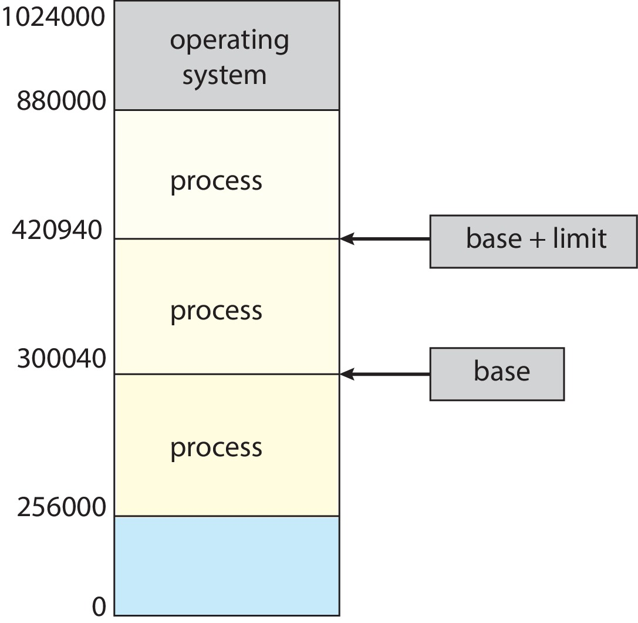
Protection
Need to ensure that a process can access only access those addresses in it address space.
We can provide this protection by using a pair of base(300040) and limit(120900) registers define the logical address space of a process
Notes:
仅能合法访问30040-420939(含)之间的地址

Slide 17
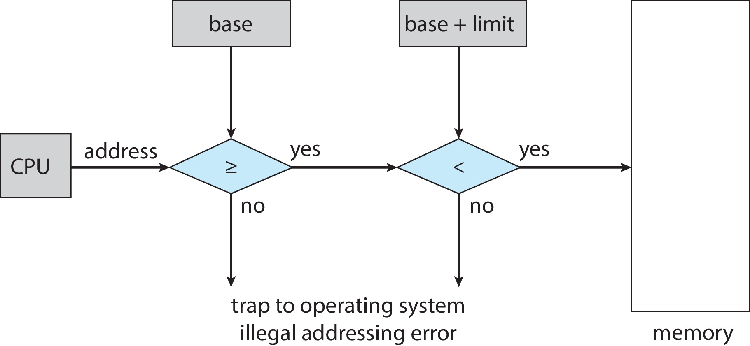
Hardware Address Protection
CPU must check every memory access generated in user mode to be sure it is between base and limit for that user
the instructions to loading the base and limit registers are privileged

Slide 18
Errata
OSC7，英文原版及翻译版，文字与Fig. 8.2不相符
那么程序可以合法访问从300040到420940（含）
改为
那么程序可以合法访问从300040到420939（含）

Slide 19
Address Binding
Programs on disk, ready to be brought into memory to execute form an input queue
Without support, must be loaded into address 0000
Inconvenient to have first user process physical address always at 0000
How can it not be?
Addresses represented in different ways at different stages of a program’s life
Source code addresses usually symbolic
Compiled code addresses bind to relocatable addresses
i.e., “18 bytes from beginning of this module”
Linker or loader will bind relocatable addresses to absolute addresses
i.e., 68018
Each binding maps one address space to another

Slide 20
Binding of Instructions and Data to Memory
Address binding of instructions and data to memory addresses can happen at three different stages
Compile time: If memory location known a priori, absolute code can be generated; must recompile code if starting location changes
Load time: Must generate relocatable code if memory location is not known at compile time
Execution time: Binding delayed until run time if the process can be moved during its execution from one memory segment to another
Need hardware support for address maps (e.g., base and limit registers)
Notes:
例如MS-DOS的.COM可执行文件在编译时就绑定了绝对地址，其第一条指令地址为CS段的0x100

Slide 21
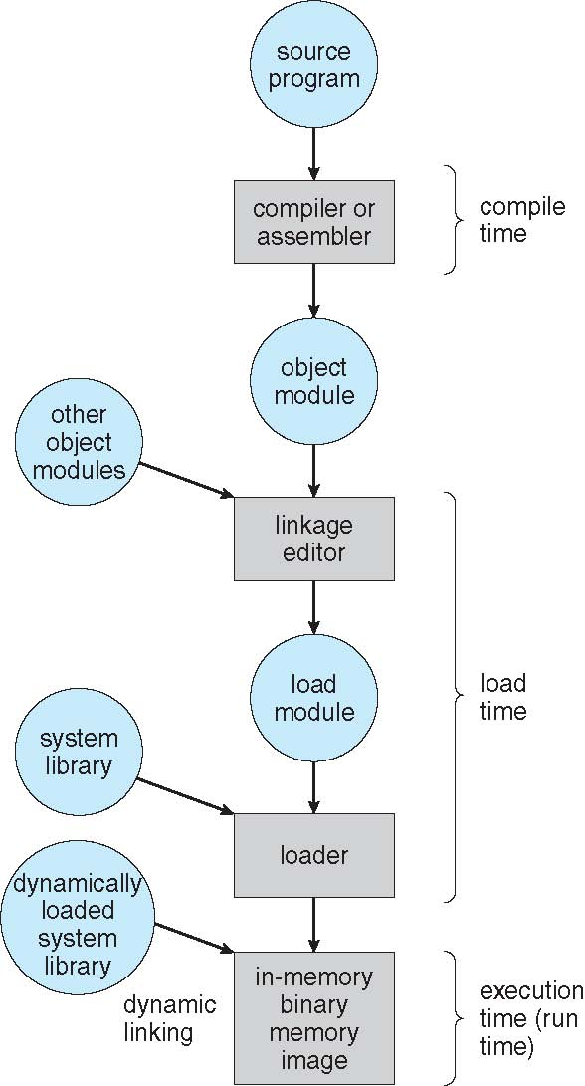
Multistep Processing of a User Program

Slide 22
Logical vs. Physical Address Space
The concept of a logical address space that is bound to a separate physical address space is central to proper memory management
Logical address(逻辑地址) – generated by the CPU; also referred to as virtual address(虚拟地址)
Physical address(物理地址) – address seen by the memory unit
Logical and physical addresses are the same in compile-time and load-time address-binding schemes; logical (virtual) and physical addresses differ in execution-time address-binding scheme
Logical address space is the set of all logical addresses generated by a program
Physical address space is the set of all physical addresses generated by a program
Notes:
逻辑地址，页称为虚拟地址

Slide 23
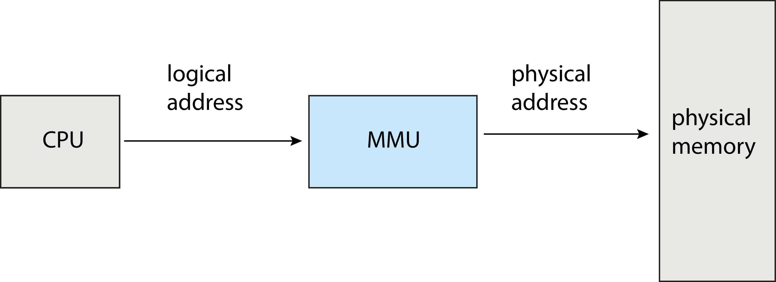
Memory-Management Unit (MMU)
Hardware device that at run time maps virtual to physical address
Many methods possible, covered in the rest of this chapter

Slide 24
Memory-Management Unit (Cont.)
Consider simple scheme. which is a generalization of the base-register scheme.
The base register now called relocation register(重定位寄存器)
The value in the relocation register is added to every address generated by a user process at the time it is sent to memory
The user program deals with logical addresses; it never sees the real physical addresses
Execution-time binding occurs when reference is made to location in memory
Logical address bound to physical addresses

Slide 25
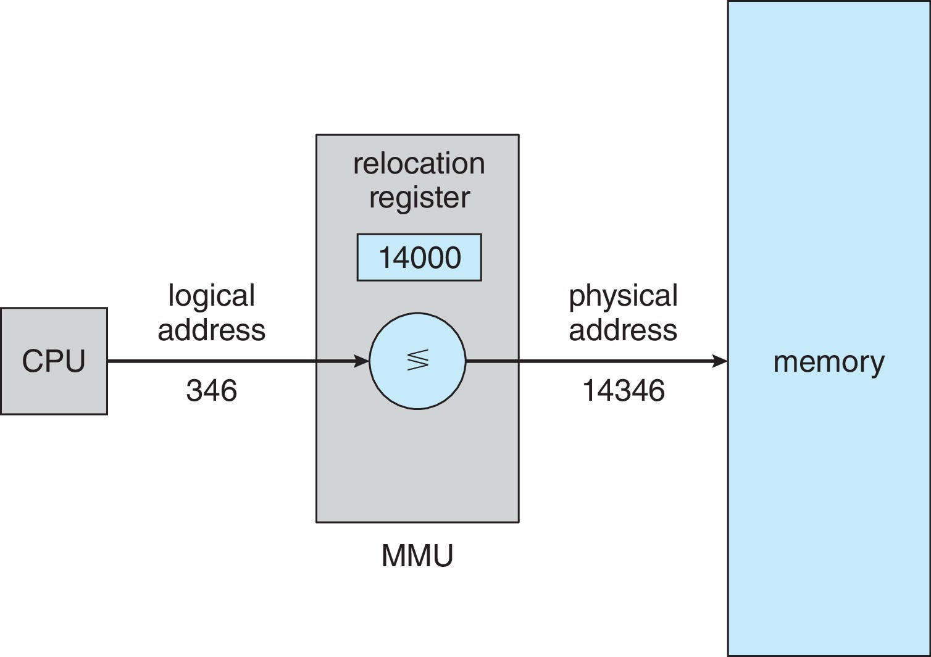
Memory-Management Unit (Cont.)
Consider simple scheme. which is a generalization of the base-register scheme.
The base register now called relocation register
The value in the relocation register is added to every address generated by a user process at the time it is sent to memory

Slide 26
Dynamic Loading
The entire program does need to be in memory to execute
Routine is not loaded until it is called
Better memory-space utilization; unused routine is never loaded
All routines kept on disk in relocatable load format
Useful when large amounts of code are needed to handle infrequently occurring cases
No special support from the operating system is required
Implemented through program design(指此动态加载主要由用户程序实现)
OS can help by providing libraries to implement dynamic loading

Slide 27
Dynamic Linking(动态链接)
Static linking(静态链接) – system libraries and program code combined by the loader into the binary program image
Dynamic linking –linking postponed until execution time
Small piece of code, stub(存根), used to locate the appropriate memory-resident library routine
Stub replaces itself with the address of the routine, and executes the routine
Operating system checks if routine is in processes’ memory address
If not in address space, add to address space
Dynamic linking is particularly useful for libraries
System also known as shared libraries(共享库)
Consider applicability to patching system libraries
Versioning may be needed

Slide 28
8.2 Swapping(交换)
A process can be swapped temporarily out of memory to a backing store(备份存储), and then brought back into memory for continued execution
Total physical memory space of processes can exceed physical memory
Backing store – fast disk large enough to accommodate copies of all memory images for all users; must provide direct access to these memory images
Roll out, roll in(滚出，滚入) – swapping variant used for priority-based scheduling algorithms; lower-priority process is swapped out so higher-priority process can be loaded and executed
Major part of swap time is transfer time(I/O time); total transfer time is directly proportional to the amount of memory swapped
System maintains a ready queue of ready-to-run processes which have memory images on disk

Slide 29
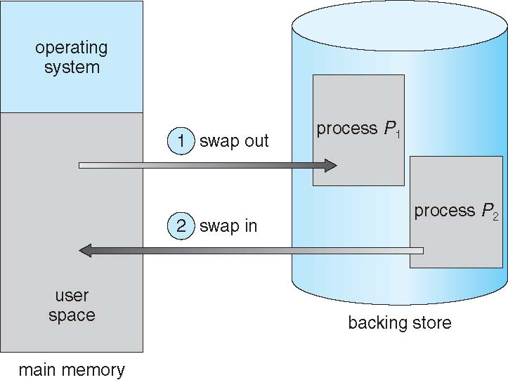
Schematic View of Swapping

Slide 30
Swapping (Cont.)
Does the swapped out process need to swap back in to same physical addresses?
Depends on address binding method
Plus consider pending I/O to / from process memory space
Modified versions of swapping are found on many systems (i.e., UNIX, Linux, and Windows)
Swapping normally disabled
Started if more than threshold amount of memory allocated
Disabled again once memory demand reduced below threshold

Slide 31
Context Switch Time including Swapping
If next processes to be put on CPU is not in memory, need to swap out a process and swap in target process
Context switch time can then be very high
100MB process swapping to hard disk with transfer rate of 50MB/sec
Swap out time of 2000 ms
Plus swap in of same sized process
Total context switch swapping component time of 4000ms (4 seconds)
Can reduce if reduce size of memory swapped – by knowing how much memory really being used
System calls to inform OS of memory use via request_memory() and release_memory()

Slide 32
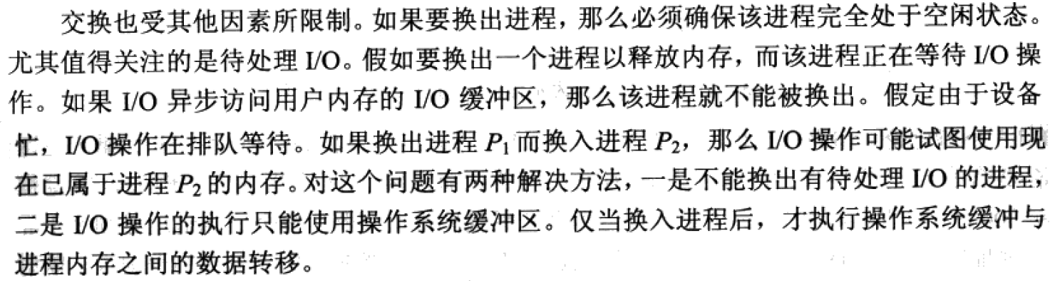
Context Switch Time and Swapping (Cont.)

Slide 33
*Swapping on Mobile Systems
Not typically supported
Flash memory based
Small amount of space
Limited number of write cycles
Poor throughput between flash memory and CPU on mobile platform
Instead use other methods to free memory if low
iOS asks apps to voluntarily relinquish allocated memory
Read-only data thrown out and reloaded from flash if needed
Failure to free can result in termination
Android terminates apps if low free memory, but first writes application state to flash for fast restart
Both OSes support paging as discussed below

Slide 34
8.3 Contiguous Allocation(连续内存分配)
Main memory must support both OS and user processes
Limited resource, must allocate efficiently
Contiguous allocation is one early method(早期的方法)
Main memory usually into two partitions:
Resident operating system, usually held in low memory with interrupt vector
User processes then held in high memory
Each process contained in single contiguous section of memory
Notes:
现代习题一般均为分页的内存管理

Slide 35
Contiguous Allocation (Cont.)
Relocation registers used to protect user processes from each other, and from changing operating-system code and data
Base register contains value of smallest physical address
Limit register contains range of logical addresses – each logical address must be less than the limit register
MMU maps logical address dynamically
Can then allow actions such as kernel code being transient(暂时) and kernel changing size

Slide 36
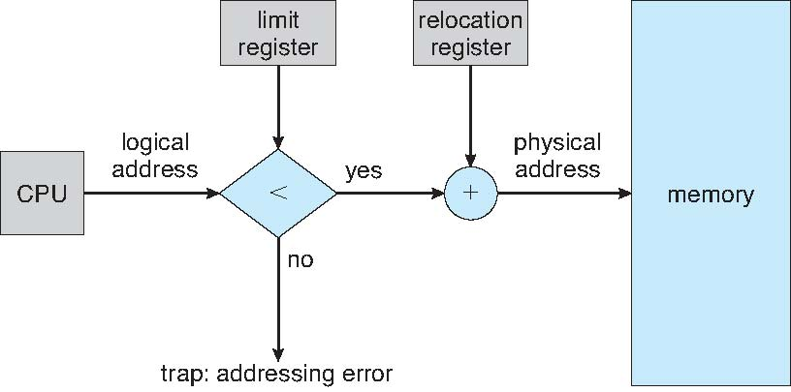
Hardware Support for Relocation and Limit Registers

Slide 37
Multi Partition Method(多分区方法)
固定大小的多分区方法，分区的个数也固定不变
将内存分为同样大小，且固定不变的多个分区，每个分区容纳一个进程
限制了多道程序的并发度
限制了每个进程内存空间的大小
对于小的进程，分区的大部分空间都浪费掉了
为早期的技术，已淘汰

Slide 38
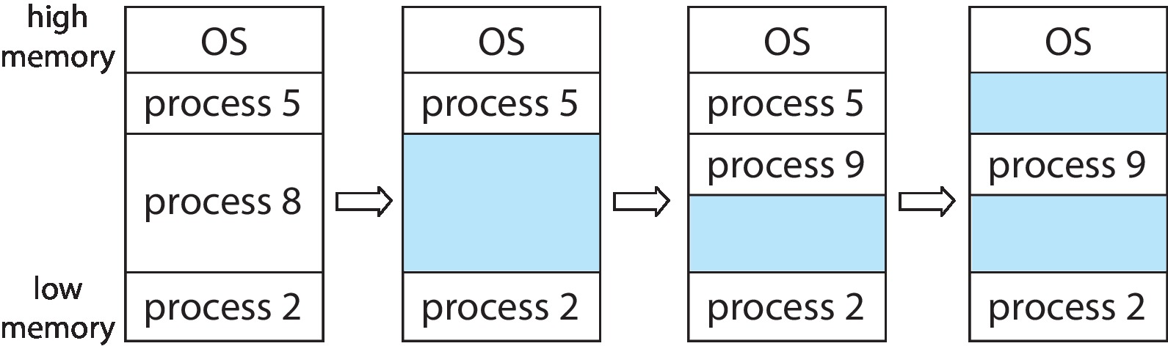
Variable Partition(可变分区)
Variable-partition allocation
Variable-partition sizes for efficiency (sized to a given process’ needs)
Hole(孔) – block of available memory; holes of various size are scattered throughout memory
When a process arrives, it is allocated memory from a hole large enough to accommodate it
Process exiting frees its partition, adjacent free partitions combined
Operating system maintains information about: a) allocated partitions b) free partitions (hole)

Slide 39
Dynamic Storage-Allocation Problem
How to satisfy a request of size n from a list of free holes?
First-fit(首次适应): Allocate the first hole that is big enough; *Next-fit(下次适应)：记住上次分配的地方，循环查找
Best-fit(最佳适应): Allocate the smallest hole that is big enough; must search entire list, unless ordered by size
Produces the smallest leftover hole
Worst-fit(最差适应): Allocate the largest hole; must also search entire list
Produces the largest leftover hole
First-fit and best-fit better than worst-fit in terms of speed and storage utilization

Slide 40
Fragmentation
External Fragmentation(外碎片) – total memory space exists to satisfy a request, but it is not contiguous
Internal Fragmentation(内碎片) – allocated memory may be slightly larger than requested memory; this size difference is memory internal to a partition, but not being used
First fit analysis reveals that given N blocks allocated, 0.5 N blocks lost to fragmentation
1/3 may be unusable -> 50-percent rule(50%规则)

Slide 41
Fragmentation (Cont.)
Reduce external fragmentation by compaction(紧缩)
Shuffle memory contents to place all free memory together in one large block
Compaction is possible only if relocation is dynamic, and is done at execution time
I/O problem
Latch job in memory while it is involved in I/O
Do I/O only into OS buffers
Now consider that backing store has same fragmentation problems

Slide 42
Which is Best？
问题：如果某操作系统中的内存请求很不规则，有时候需要很大的一个内存块，有时候又很小，此时用哪种分区分配算法最好? ( )
A. First-fit(首次适应)
B. Best-fit(最佳适应)
C. Worst-fit(最差适应)
D. Next-fit(下次适应)
E. 没有区别
√

Slide 43
8.4 Paging(分页)
Physical address space of a process can be noncontiguous; process is allocated physical memory whenever the latter is available
Avoids external fragmentation
Avoids problem of varying sized memory chunks
Divide physical memory into fixed-sized blocks called frames(帧，页框)
Size is power of 2, between 512 bytes and 16 Mbytes
Divide logical memory into blocks of same size called pages(页)
Keep track of all free frames
To run a program of size N pages, need to find N free frames and load program
Set up a page table(页表) to translate logical to physical addresses
Backing store likewise split into pages
Still have internal fragmentation

Slide 44
Address Translation Scheme
For given logical address space 2^{m} and page size 2^{n}
Address generated by CPU is divided into:
Page number (p) – used as an index into a page table which contains base address of each page in physical memory
Page offset (d) – combined with base address to define the physical memory address that is sent to the memory unit
page number
page offset
p
d
(m – n) bit
n bit

Slide 45
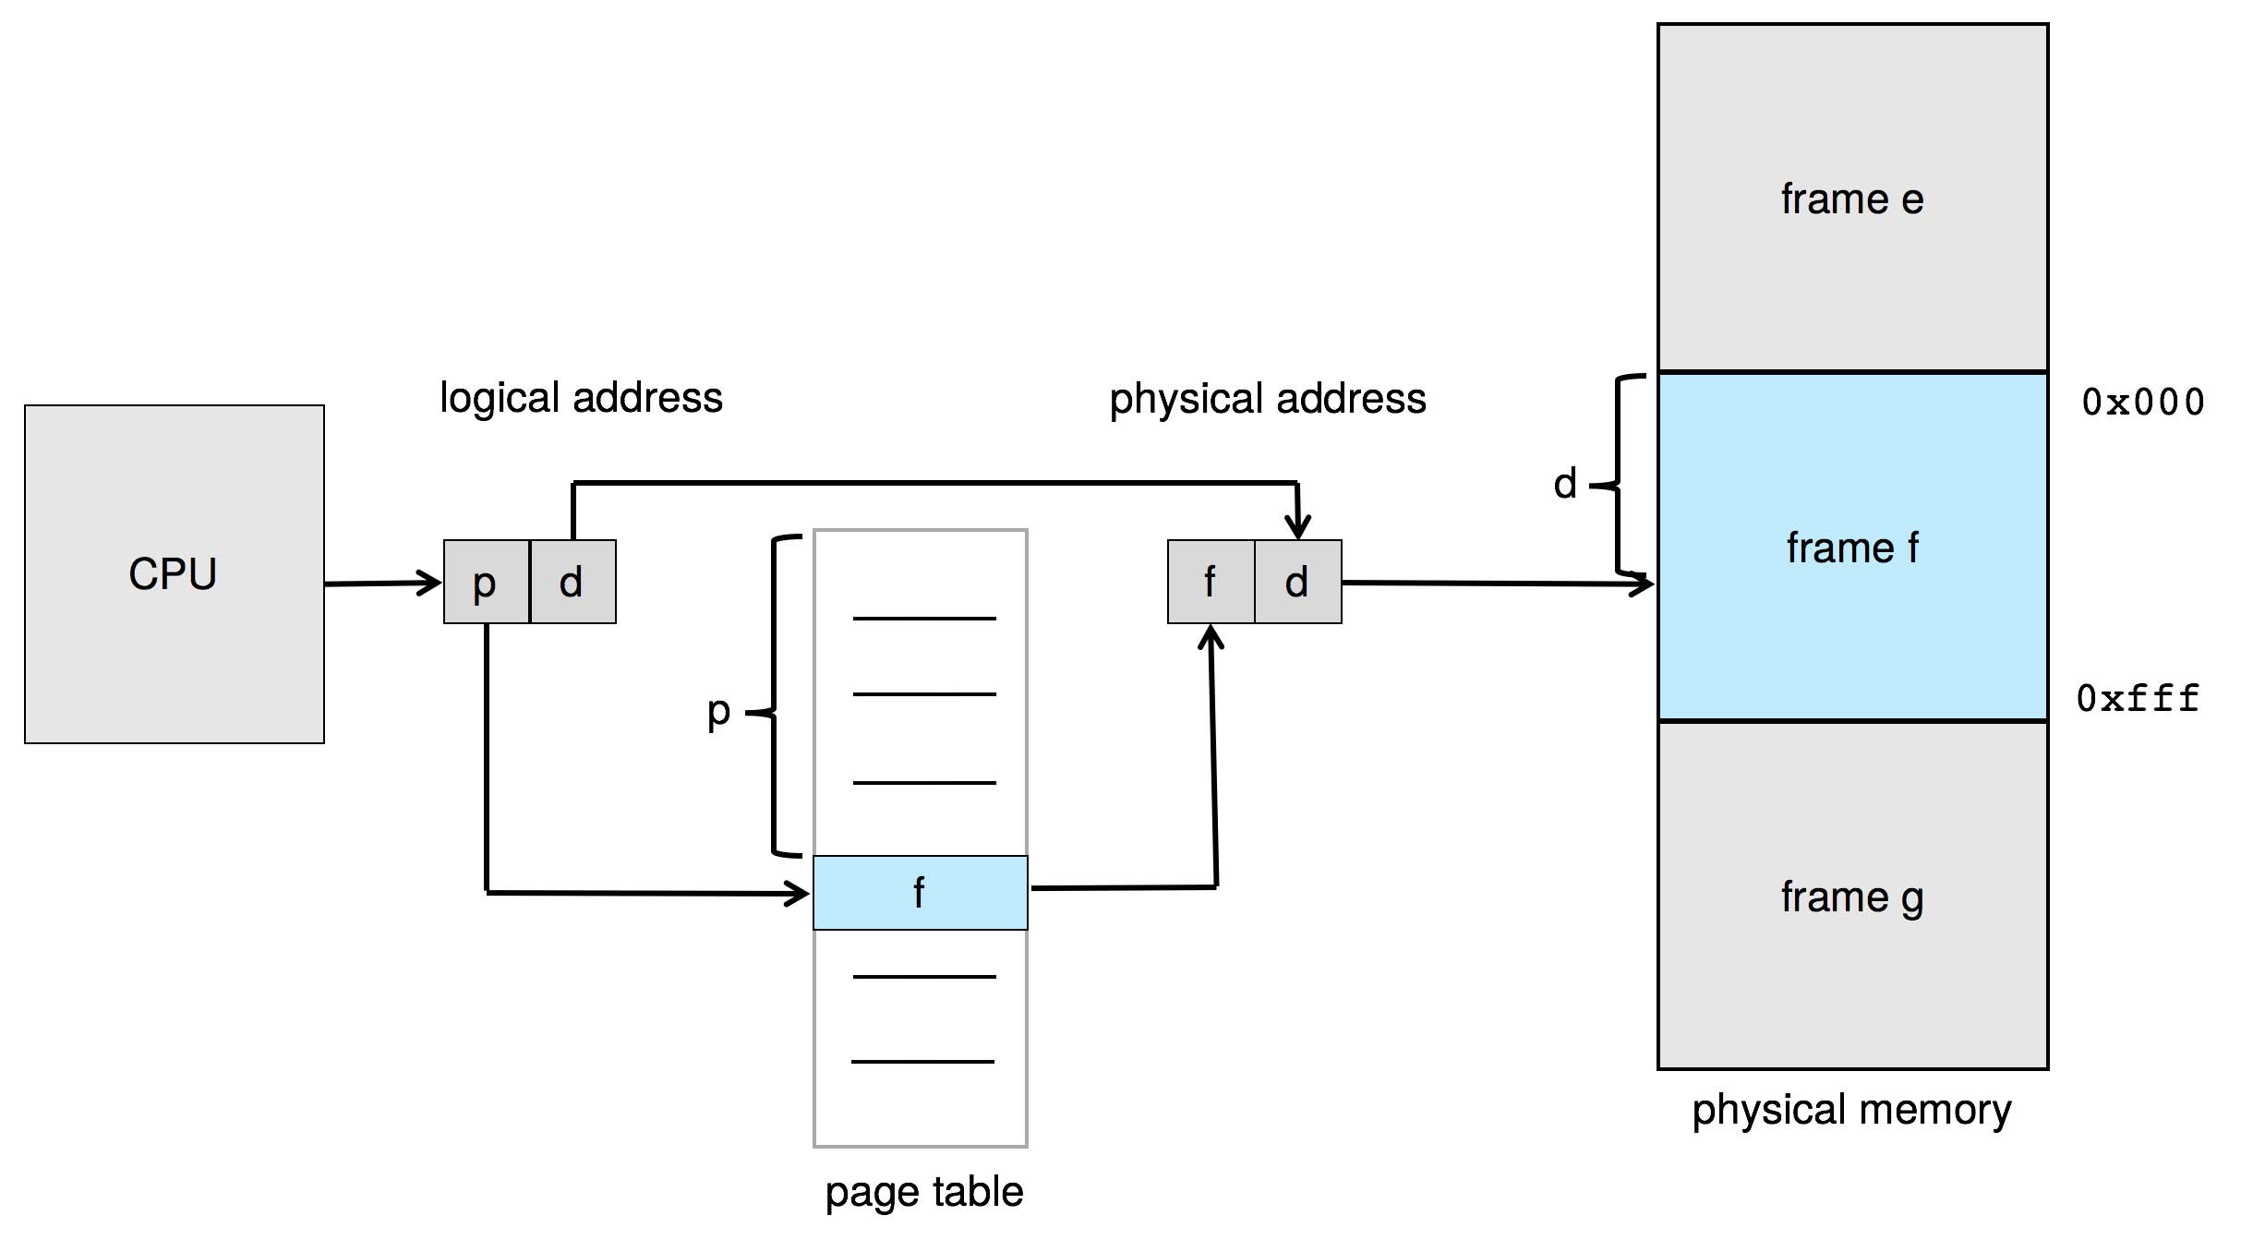
Paging Hardware
页表也存储在物理内存中

Slide 46
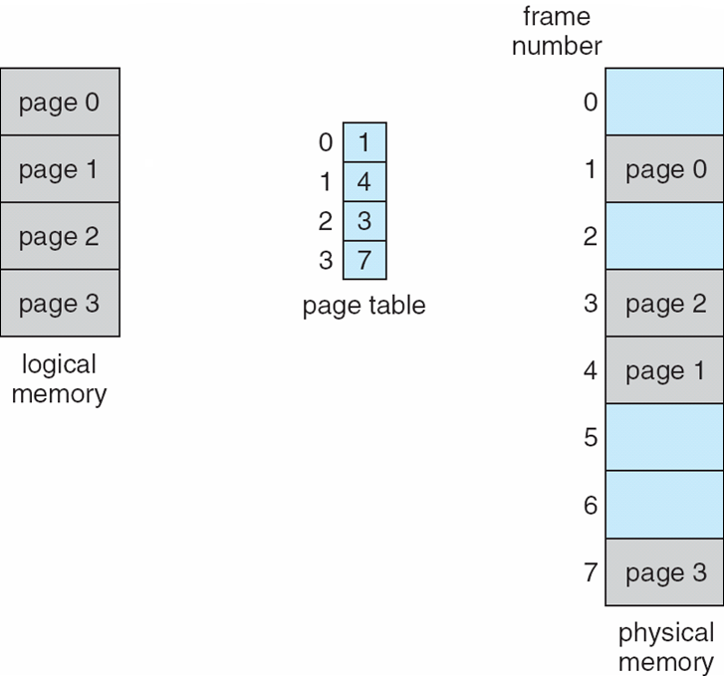
Paging Model of Logical and Physical Memory

Slide 47
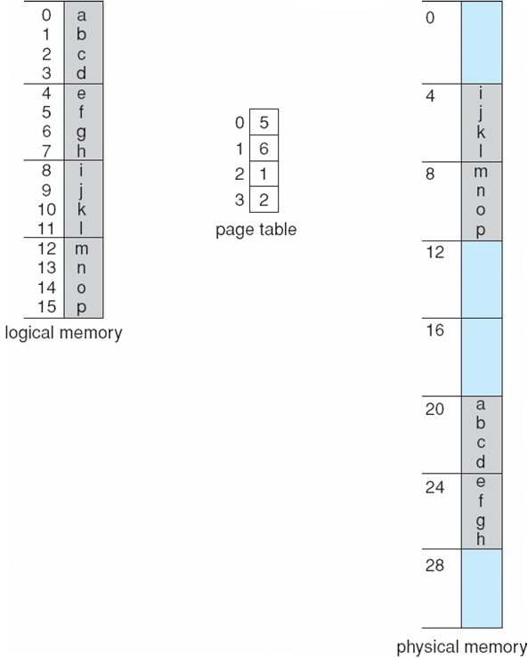
Paging Example
Logical address:
n = 2 and m = 4.
2 bit页偏移，4 bit逻辑地址，2 bit 页号
Using a page size of 4 bytes and a physical memory of 32 bytes (8 pages)

Slide 48
Paging -- Calculating Internal Fragmentation
Page size = 2,048 bytes, Process size = 72,766 bytes
35 pages + 1,086 bytes
Internal fragmentation of 2,048 - 1,086 = 962 bytes
Worst case fragmentation = 1 frame – 1 byte
On average fragmentation = 1 / 2 frame size
So small frame sizes desirable?
But each page table entry takes memory to track
Page sizes growing over time
Solaris supports two page sizes – 8 KB and 4 MB
No external fragmentation(完全没有外碎片)

Slide 49
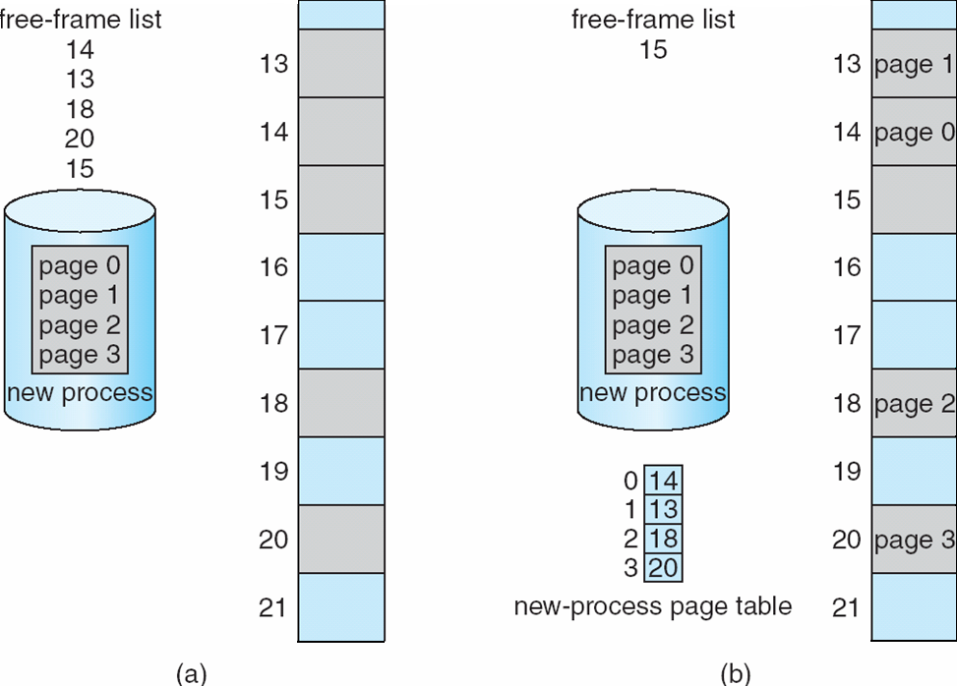
Free Frames
内存灰色部分为空闲帧，蓝色部分为其他进程已分配帧
Before allocation
After allocation

Slide 50
View of Memory with Paging
用户视角的内存与实际物理内存分离
用户程序将内存作为一整块来处理，且仅包含这一个进程(看不到其他进程的内存空间)
但在物理上，该用户进程与其他进程一起，分布在物理内存上
用户视角的内存与实际物理内存的映射是通过地址转换硬件协调，将逻辑地址转化为物理地址
该映射对用户透明，但受操作系统控制
由于页表机制的存在，用户进程无法访问其页表规定之外的内存

Slide 51
Frame Table(帧表)
Physical memory is managed by the operating system only
The OS must be aware of the allocation details of physical memory
How many total frames there are, and so on.
Generally kept in a single, system-wide data structure called frame table
The frame table has one entry for each physical page frame, indicating whether the latter is free or allocated and, if it is allocated, to which page of which process (or processes)

Slide 52
Implementation of Page Table
Page table is kept in main memory
Page-table base register (PTBR，页表基寄存器) points to the page tablePage-table length register (PTLR，页表长度寄存器) indicates size of the page table
In this scheme every data/instruction access requires two memory accesses(内存访问速度减半，无法忍受)
One for the page table and one for the data / instruction
The two-memory access problem can be solved by the use of a special fast-lookup hardware cache called translation look-aside buffers (TLBs，转换表缓冲区，快表) (also called associative memory，联想存储器)
问题：页表基寄存器PTBR内的值是逻辑地址还是物理地址？(物理地址)
Notes:
相应地，有时也把普通页表page table称为慢表。
最下面问题答案：物理地址

Slide 53
Translation Look-Aside Buffer(快表)
TLBs typically small (64 to 1,024 entries)，通常仅缓存了页表的一小部分
On a TLB miss, value is loaded into the TLB for faster access next time
Replacement policies must be considered
Some entries can be wired down(指的这些项目固定不变，不会被替换掉) for permanent fast access
Some TLBs store address-space identifiers (ASIDs，地址空间标识符) in each TLB entry – uniquely identifies each process to provide address-space protection for that process
Otherwise need to flush TLB at every context switch(If w/o ASIDs)

Slide 54
Hardware
Associative memory – parallel search
Page# 123
Address translation (p, d)
If p is in associative register, get frame # out
Otherwise get frame # from page table in memory
Page # | Frame #
111 | 255
88 | 990
123 | 600
222 | 889
Frame# 600

Slide 55
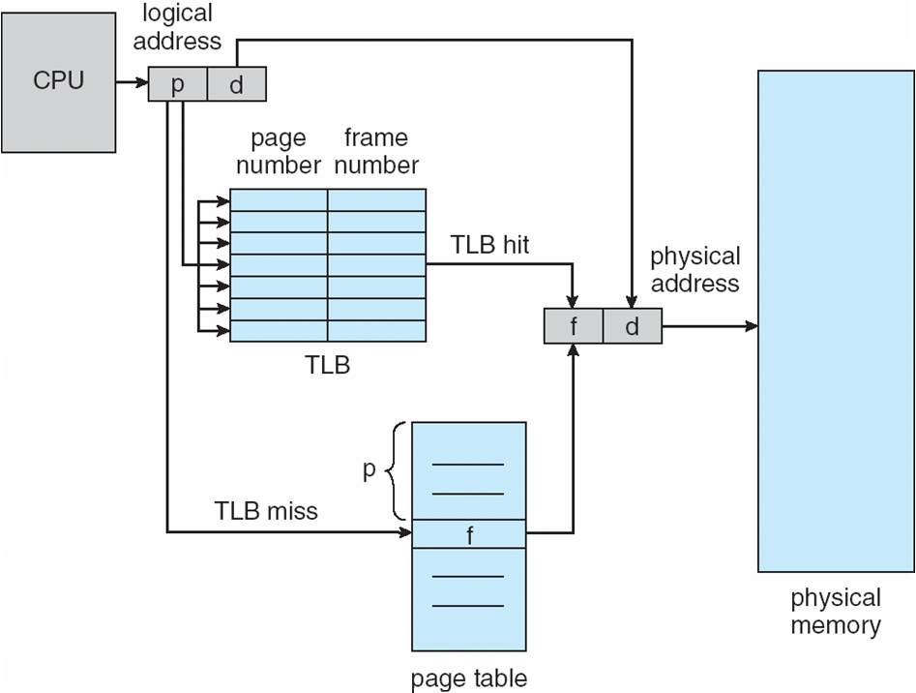
Paging Hardware With TLB

Slide 56
Effective Access Time
Hit ratio – percentage of times that a page number is found in the TLB
An 80% hit ratio means that we find the desired page number in the TLB 80% of the time.
Suppose TLB lookup time is 20 ns
Suppose that 100 nanoseconds to access memory.
If we find the desired page in TLB then a mapped-memory access take 120 ns
Otherwise we need two memory access, plus TLB time, so it is 220 ns
Effective Access Time (EAT，有效内存访问时间)
EAT = 0.80 x 120 + 0.20 x 220 = 140 nanoseconds
implying 40% slowdown in access time(from 100 ns to 140 ns)
Consider amore realistic hit ratio of 98%,
EAT = 0.98 x 120 + 0.02 x 220 = 122ns
implying only 22% slowdown in access time.
Notes:
TLB有效的前提是比较高的TLB命中率，依靠局部性(locality)原理

Slide 57
Memory Protection
Memory protection implemented by associating protection bit with each frame to indicate if read-only or read-write access is allowed
Can also add more bits to indicate page execute-only, and so on
Valid-invalid bit attached to each entry in the page table:
“valid” indicates that the associated page is in the process’ logical address space, and is thus a legal page
“invalid” indicates that the page is not in the process’ logical address space
Or use page-table length register (PTLR)
Any violations result in a trap to the kernel

Slide 58
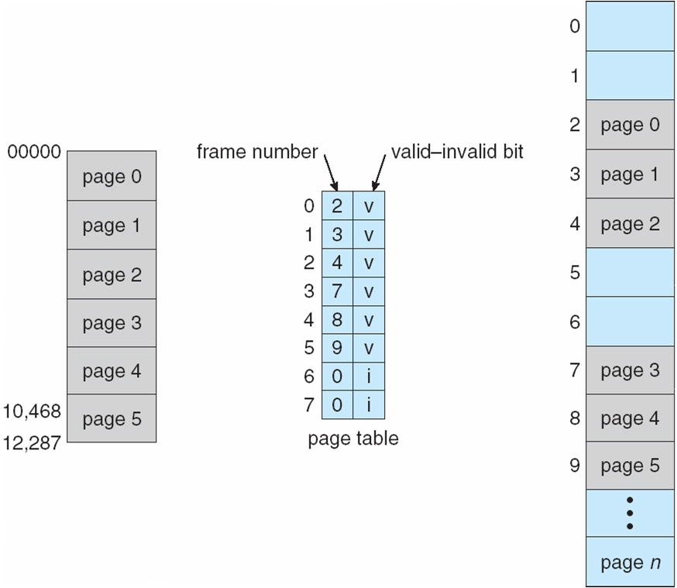
Valid (v) or Invalid (i) Bit In A Page Table
14位地址空间(0-16383)的系统，分为8个2K的页框。右图所示有更多的物理帧数
假如一个程序的有效地址空间为0-10468，需6个2K的页框
page 5在10468之外，还包括了10469-12287。此段地址未受保护，也是内碎片

Slide 59
Shared Pages(共享页)
Shared code
One copy of read-only (reentrant，可重入代码，纯代码，pure code) code shared among processes (i.e., text editors, compilers, window systems)
Similar to multiple threads sharing the same process space
Also useful for interprocess communication if sharing of read-write pages is allowed
Private code and data
Each process keeps a separate copy of the code and data
The pages for the private code and data can appear anywhere in the logical address space
Notes:
若一个程序或子程序可以安全的被并行执行，则称其为可重入（reentrant或re-entrant）的；即，当该子程序正在运行时，可以再次进入并执行它。若一个函数是可重入的，则该函数：不能含有静态（全局）非常量数据。不能返回静态（全局）非常量数据的地址。 只能处理由调用者提供的数据。不能依赖于单实例模式资源的锁。不能调用不可重入的函数。多'用户/对象/进程优先级'以及多进程一般会使得对可重入代码的控制变得复杂。同时，IO代码通常不是可重入的，因为他们依赖于像磁盘这样共享的、单独的资源。

Slide 60
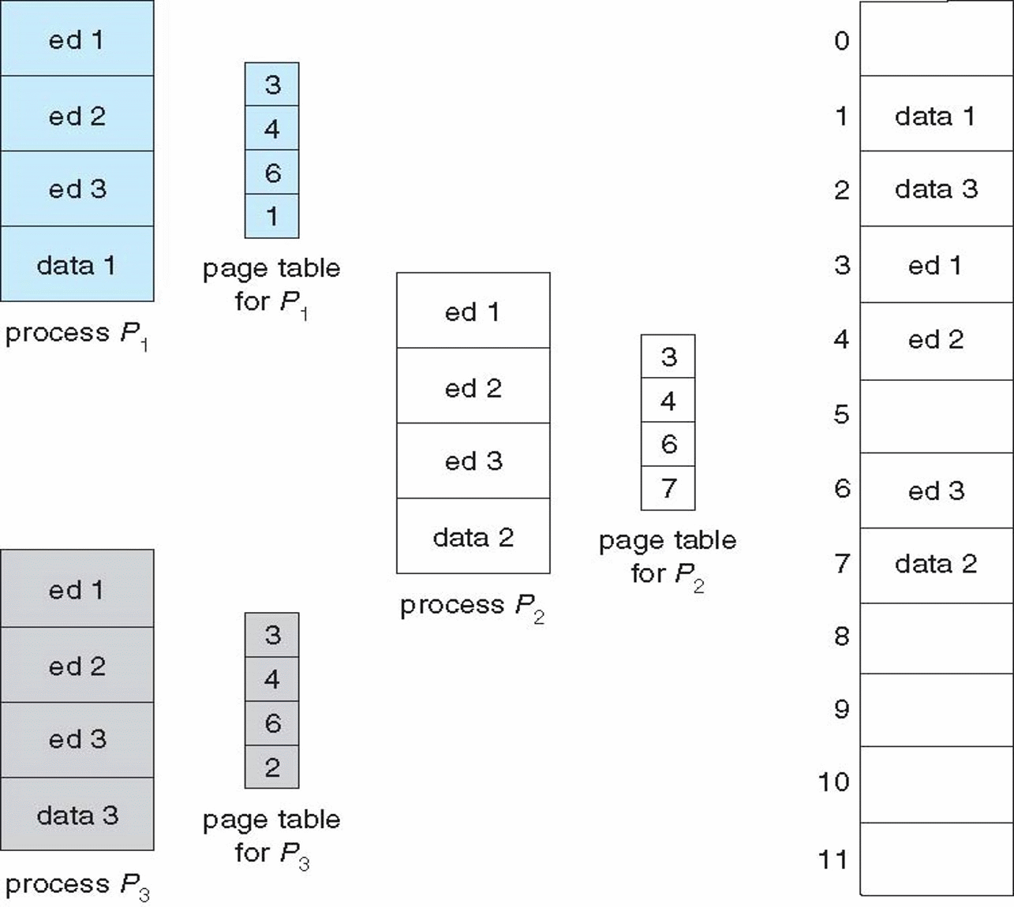
Shared Pages Example

Slide 61
Errata
OSC7，翻译版，图8.13
左下角
“进程P2”及“P2的页表”
改为
“进程P3”及“P3的页表”

Slide 62
8.5 Structure of the Page Table(页表结构)
Memory structures for paging can get huge using straight-forward methods
Consider a 32-bit logical address space as on modern computers
Page size of 4 KB (2¹²)
Page table would have 1 million entries (2³² / 2¹²)，页表条目数过多
If each entry is 4 bytes ➔ each process 4 MB of physical address space for the page table alone，整个页表相当大，而页表需要在物理内存连续存储
Don’t want to allocate that contiguously in main memory
One simple solution is to divide the page table into smaller units
Hierarchical Paging(层次页表)
Hashed Page Tables(哈希页表)
Inverted Page Tables(反向页表，倒置页表)

Slide 63
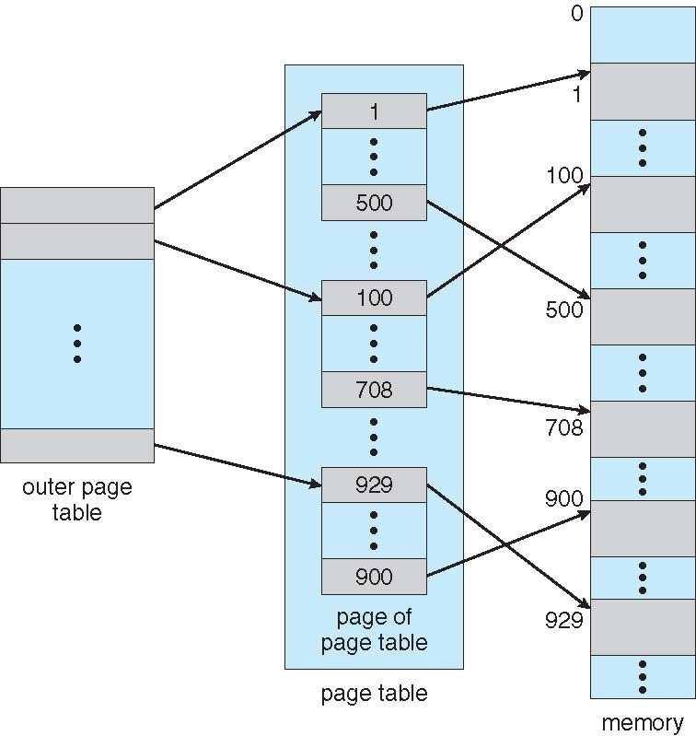
Hierarchical Page Tables
图示为两级层次页表
Break up the logical address space into multiple page tables
A simple technique is a two-level page table(二级页表)
We then page the page table(把页表再分页)

Slide 64
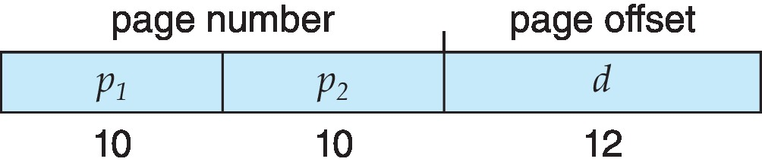
两级页表举例
32-bit 机器，4KB 页大小，其逻辑地址划分为两部分:
20-bit 页号
12-bit 页内偏移
因为需要把页表再分页，20-bit 的页号进一步划分为：
10-bit 页号
10-bit 页表偏移(页表的页)
Thus, a logical address is as follows:
p₁ 用来访问外部页表的索引, p₂ 是页表的页的偏移
Known as forward-mapped page table(向前映射页表)

Slide 65
Two-Level Paging Example
A logical address (on 32-bit machine with 4KB page size) is divided into:
a page number consisting of 20 bits
a page offset consisting of 12 bits
Since the page table is paged, the page number is further divided into:
a 10-bit page number
a 10-bit offset of page table(page of page table)
Thus, a logical address is as follows:
where p₁ is an index into the outer page table, and p₂ is the displacement within the page of the inner page table
Known as forward-mapped page table(向前映射页表)

Slide 66
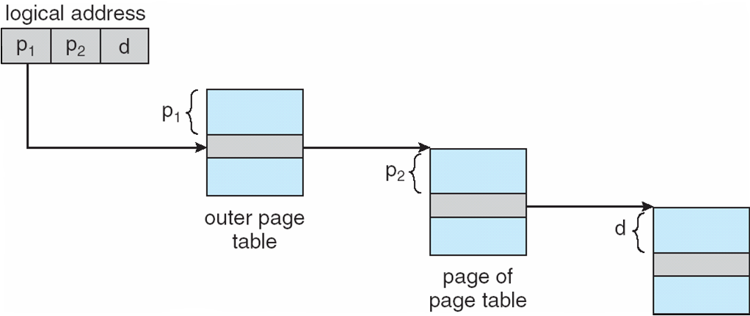
Address-Translation Scheme
外页表
页表的页
Notes:
其他称呼：
顶级页表 + 二级页表；
外部页表 + 内部页表；
页目录表 + 页表(页目录号 + 页号)

Slide 67
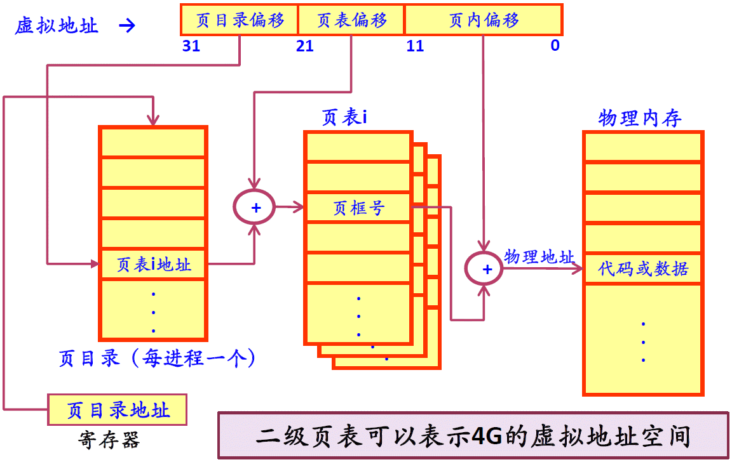
二级页表结构及地址映射

Slide 68
两级页表的不同称呼
外页表，页表的页
顶级页表，二级页表
外部页表，内部页表
页目录表，页表；页目录号，页号

Slide 69
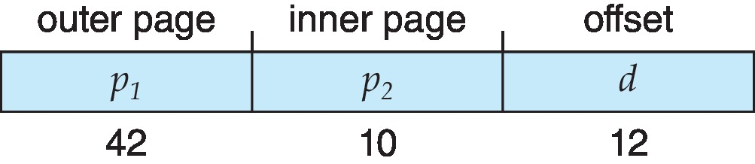
64-bit Logical Address Space
Even two-level paging scheme not sufficient
If page size is 4 KB (2¹²)
Then page table has 2⁵² entries
If two level scheme, inner page tables could be 2¹⁰ 4-byte entries
Address would look like
Outer page table has 2⁴² entries or 2⁴⁴ bytes
One solution is to add a 2nd outer page table
But in the following example the 2nd outer page table is still 2³⁴ bytes in size
And possibly 4 memory access to get to one physical memory location

Slide 70
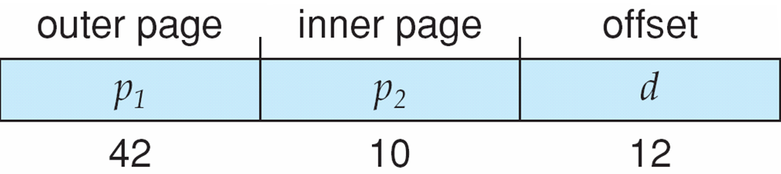
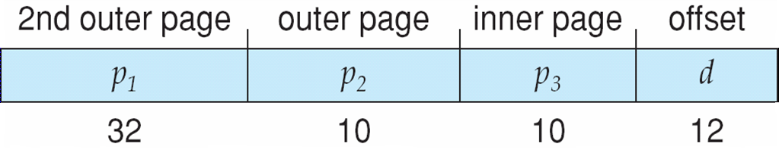
Three-level Paging Scheme

Slide 71
Intel x86-64(AMD64)
Current generation Intel x86 architecture
64 bits is ginormous (> 16 exabytes, = 16 EiB)
In practice only implement 48 bit addressing
Page sizes of 4 KB(下面以4 KB页表为例), 2 MB, 1 GB
Four levels of paging hierarchy(4级页表)
Can also use PAE(物理地址扩展) so virtual addresses are 48 bits and physical addresses are 52 bits
8 bytes per page table entry(每个页表项占8字节，512项)
Notes:
名字 缩写 次方 名字 缩写 次方
kilobyte KB 10^3 kibibyte KiB 2^10
megabyte MB 10^6 mebibyte MiB 2^20
gigabyte GB 10^9 gibibyte GiB 2^30
terabyte TB 10^12 tebibyte TiB 2^40
petabyte PB 10^15 pebibyte PiB 2^50
exabyte EB 10^18 exbibyte EiB 2^60
zettabyte ZB 10^21 zebibyte ZiB 2^70
yottabyte YB 10^24 yobibyte YiB 2^80

Slide 72
Hashed Page Tables(哈希页表)
Common in address spaces > 32 bits(在地址空间为32-bit以上的机器上常见)
The virtual page number is hashed into a page table(虚拟页码运算成哈希值，再查表)
This page table contains a chain of elements hashing to the same location
Each element contains three fields (1) the virtual page number 虚拟页码(2) the value of the mapped page frame 帧号(3) a pointer to the next element 下一项指针(处理哈希碰撞)
Notes:
来自DB相关的解释：聚簇表，简单来说就是利用选取一个或多个列作为cluster key，具有相同cluster key的一个或多个表的数据行会被保留在同一个数据块中

Slide 73
Hashed Page Tables(哈希页表)
虚拟页号的哈希值，作为哈希页表的偏移量查表
Virtual page numbers are compared in this chain searching for a match
If a match is found, the corresponding physical frame is extracted
Variation for 64-bit addresses is clustered page tables(群集页表，聚簇页表)
Similar to hashed but each entry refers to several pages (such as 16) rather than 1
Especially useful for sparse address spaces (稀疏地址空间，where memory references are non-contiguous and scattered)
采用群集页表，可以大大压缩页表的项数，比如1/16
Notes:
聚簇表，简单来说就是利用选取一个或多个列作为cluster key，具有相同cluster key的一个或多个表的数据行会被保留在同一个数据块中

Slide 74
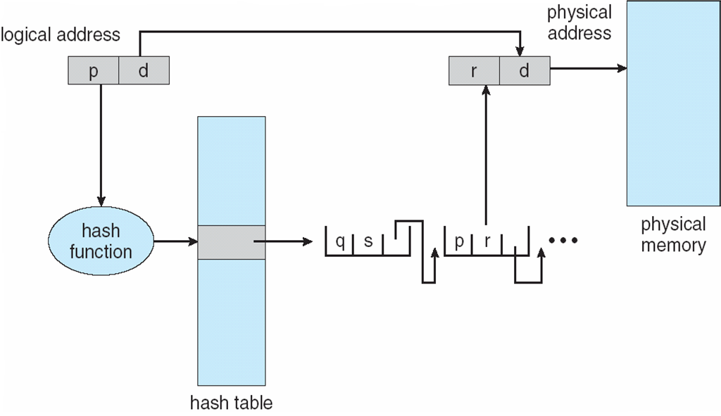
Hashed Page Table
0
1
…
h

Slide 75
Inverted Page Table(反向页表，倒置页表，倒排页表)
Rather than each process having a page table and keeping track of all possible logical pages, track all physical pages(for all processes) in a single table
One entry for each real page of memory
Entry consists of the virtual address of the page stored in that real memory location, with information about the process that owns that page
Decreases memory needed to store each page table, but increases time needed to search the table when a page reference occurs
Use hash table to limit the search to one — or at most a few — page-table entries
TLB can accelerate access

Slide 76
反向页表(倒置页表，倒排页表)
地址转换(前面讲的普通页表方式)
从虚拟地址空间出发：虚拟地址 → 查页表 → 得到页框号 → 加页内偏移量，形成物理地址
需每个进程一张页表，占用内存空间较大
解决思路
从物理地址空间出发，系统仅建立一张反向页表(与进程数无关)
页表项记录进程的某虚拟地址(进程id及虚页号)与页框号的映射关系
这种实现方式称为反向页表，或倒置页表，或倒排页表
若直接查找反向页表，速度无法忍受
反向页表可采用哈希方法以加快查找速度
可反向页表 + TLB：先查TLB，不命中再查反向页表

Slide 77
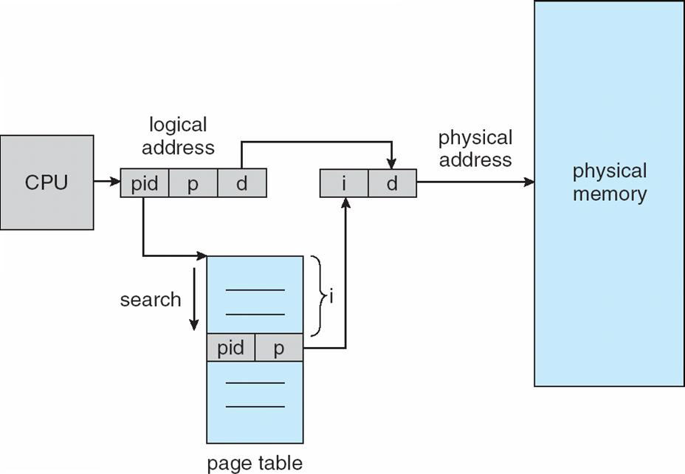
Inverted Page Table Architecture

Slide 78
Shared Memory with Inverted Page Table
There is only one virtual page entry for every physical page, one physical page cannot have two (or more) shared virtual addresses
Only one mapping of a virtual address to the shared physical address may occur at any given time(反向页表同一时间，只能给共享内存中的一个进程P1提供虚拟地址到物理地址的转换)
A reference by another process sharing the memory will result in a page fault and will replace the mapping with a different virtual address(其他进程P2访问其共享内存的虚拟地址时，不能在反向页表中查找到相应的表项，会产生页故障，这将陷入OS，OS通过查看有关共享页的其他数据结构，把共享内存页的虚拟地址修改为P2的)

Slide 79
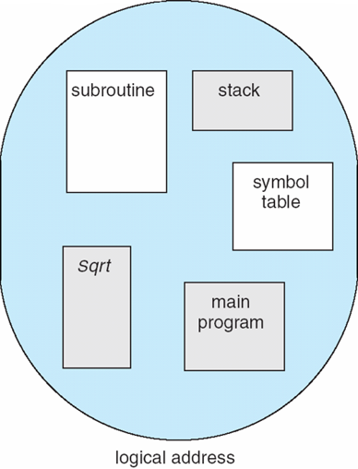
8.6 Segmentation(分段)
Memory-management scheme that supports user view of memory
A program is a collection of segments.
A segment is a logical unit such as:
main program, procedure,
function, method, object,
local variables, global variables,
common block, stack,
symbol table, arrays

Slide 80
段式内存管理方案
用户进程地址空间：按程序自身的逻辑关系划分为若干个程序段，每个程序段都有一个段名(段号)
内存空间被动态划分为若干长度不相同的区域，称为物理段，每个物理段由起始地址和长度确定
内存分配（规则）：以段为单位进行分配，每段在内存中占据连续空间，但各段之间可以不相邻
逻辑地址：
段号 | 段内地址

Slide 81
Logical View of Segmentation
1
1
4
2
3
4
2
3
user space
physical memory space

Slide 82
Segmentation Architecture
Logical address consists of a two tuple:
<segment-number, offset>,
Segment table(段表) – maps two-dimensional(二维) physical addresses; each table entry has(段表的每一项含有):
Base(段基址) – contains the starting physical address where the segments reside in memory
Limit(段界限) – specifies the length of the segment
Segment-table base register (STBR，段表基寄存器) points to the segment table’s location in memory
Segment-table length register (STLR，段表长度寄存器) indicates number of segments used by a program;
segment number s is legal if s < STLR

Slide 83
段表及地址转换
段表
每项记录了段号、段首地址和段长度之间的关系
每个进程一个段表，存放在内存
段表起始地址保存在何处？
物理内存管理
地址转换（硬件）
CPU取到逻辑地址，用段号查段表，得到该段在内存的起始地址，与段内偏移地址计算出物理地址
段号 | 段内地址

Slide 84
段表寄存器
在分段系统中，段表被保存在物理内存中。
段表寄存器是CPU中的一个硬件设施，用来存放当前正在运行的进程其段表在物理内存中的起始物理地址。
当系统调度某个进程运行时，它将从该进程的PCB中取出相应的值填入段表寄存器

Slide 85
Segmentation Architecture (Cont.)
Protection
With each entry in segment table associate:
validation bit = 0 ⇒ illegal segment
read/write/execute privileges
Protection bits associated with segments; code sharing occurs at segment level
Since segments vary in length, memory allocation is a dynamic storage-allocation problem
A segmentation example is shown in the following diagram

Slide 86
Segment Protection
越界检查
为了进行越界检查，系统在段表寄存器中保存当前进程的段表长度并在每个段表项中保存各个段的长度
存取控制
为了进行存取控制，系统在每个段表项中设置一个 “存取控制”字段，用于规定进程对段的访问权限(读写，只读，只执行等)

Slide 87
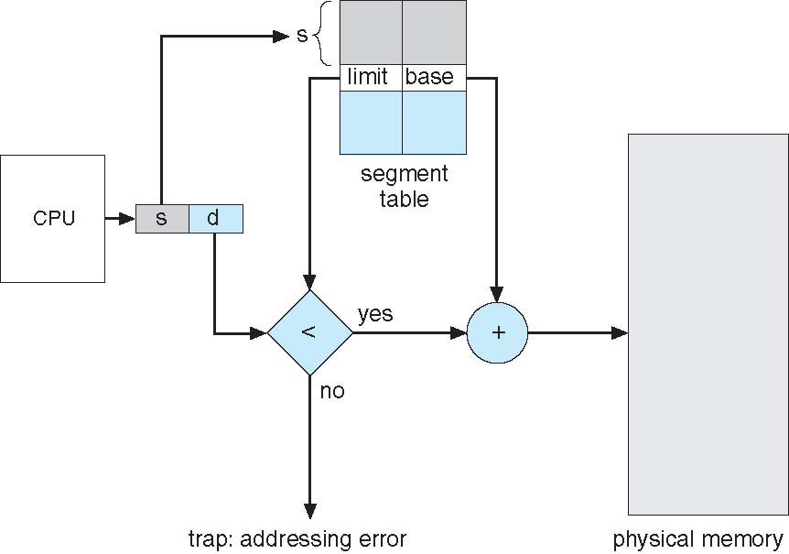
Segmentation Hardware

Slide 88
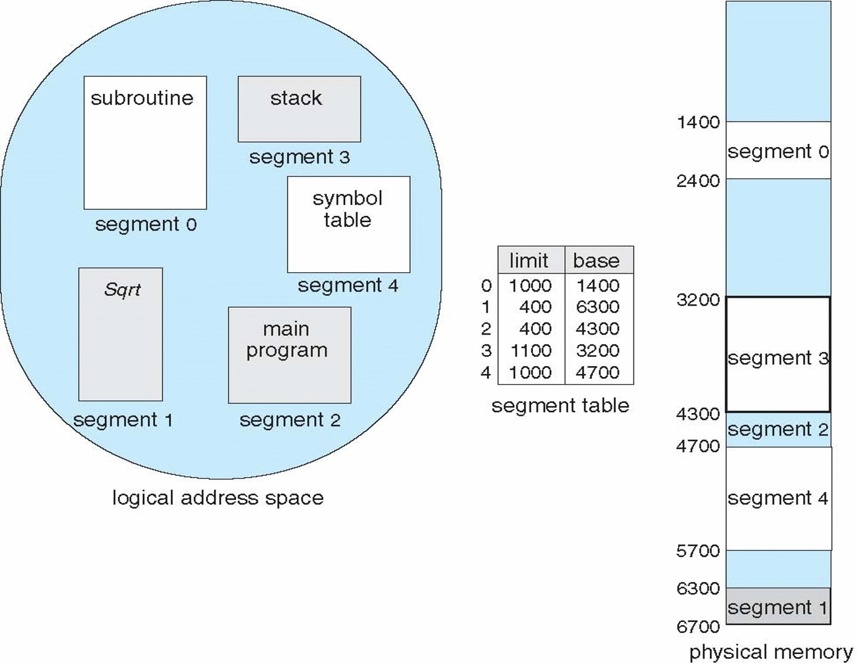
Example of Segmentation

Slide 89
Paging vs. Segmentation
页面是信息的物理单位；在特定的系统中其大小是固定不变的，不随进程的不同而不同
段是信息的逻辑单位，其长度不定；即使是属于同一进程的两个段其长度也可能不等
分页活动源于系统管理物理内存的需要，在系统内部进行，由系统实施，用户看不见
分段活动源于用户进行模块化程序设计的需要，在系统外部进行，由用户实施，用户是知道的

Slide 90
Paging vs. Segmentation
在分页系统中，逻辑地址是一维的
在分段系统中，逻辑地址是二维或多维的
分页系统中，内碎片得到了有效的抑制，外碎片则完全被消除；因此，使用分页技术可以提高物理内存的利用率
分段系统中，动态数据结构、程序和数据共享、程序和数据保护等问题得到了妥善解决；因此，分段技术有利于模块化程序设计
后面讲述的段页技术结合了分页技术和分段技术的优点

Slide 91
*Segmentation with Paging(段页式)
Add page table to each entry of segmentation table
s
Offset
s
p
offset
Logical address
Physical address
s
p
offset
f
offset
s
p
+
+
f
STBR
Segmentation table
page table of S

Slide 92

*段页式内存管理
在段页存储管理系统中，每个进程均被编程人员分割成多个Segment， 每个段又被系统分割成多个Page
先按段划分，每一段再按页面划分
相应地，物理内存被系统划分成多个Frame
当一个进程被装入物理内存时，系统为该进程的每个段的各页面独立地分配一个Frame；因为分页的存在，一个进程中的同一个段的多个页面，不必存放在连续的多个Frame中
x86-32及x86-64均采用段页式内存管理

Slide 93
*8.7 Example: The Intel Pentium
Supports both segmentation and segmentation with paging
IA-32 CPU generates logical address
Given to segmentation unit
Which produces linear addresses(线性地址)
Linear address given to paging unit
Which generates physical address in main memory
Paging units form equivalent of MMU

Slide 94

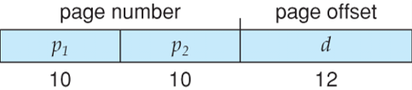
Logical to Physical Address Translation in IA-32
Segmentation with paging
Paging

Slide 95
Intel Pentium Segmentation
Segmentation:4G (2^32)
Per process has 16K(2^14) segs max.
First 8K: local descriptor table (LDT)
Last 8K: global descriptor table (GDT)
The logical address is a pair (selector, offset) 16+32 = 48 bits
Selector:16 bits (13+1+2)
s designates the segment number
g indicates whether the segment is in the GDT or LDT
p deals with protection.
offset specifying the location of the byte within the segment.
13
1
2
32
s
g
p
offset

Slide 96
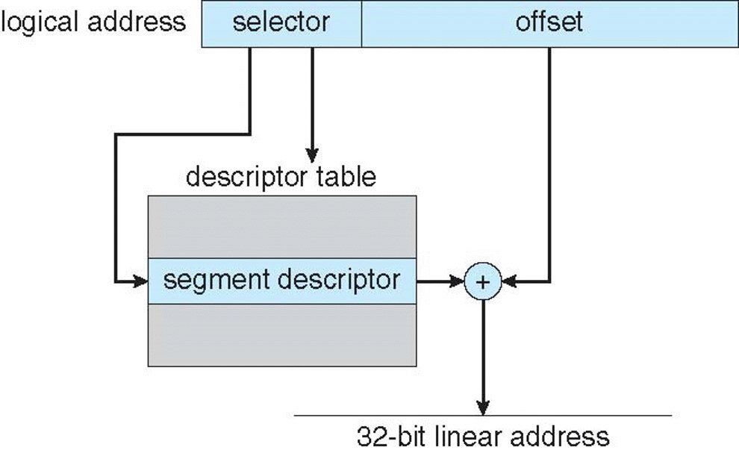
IA-32 Intel Pentium Segmentation
13
1
2
32
s
g
p
offset

Slide 97
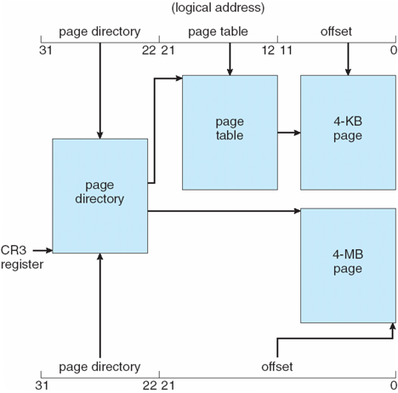
IA-32 Pentium Paging Architecture
page size:
either 4 KB: 2^12
or 4 MB: 2^22

Slide 98

Linear Address in Linux
Linux uses only 6 segments (kernel code, kernel data, user code, user data, task-state segment (TSS), default LDT segment)
Linux only uses two of four possible modes – kernel and user
Uses a three-level paging strategy that works well for 32-bit and 64-bit systems
Linear address broken into four parts:
But the Pentium only supports 2-level paging?!

Slide 99
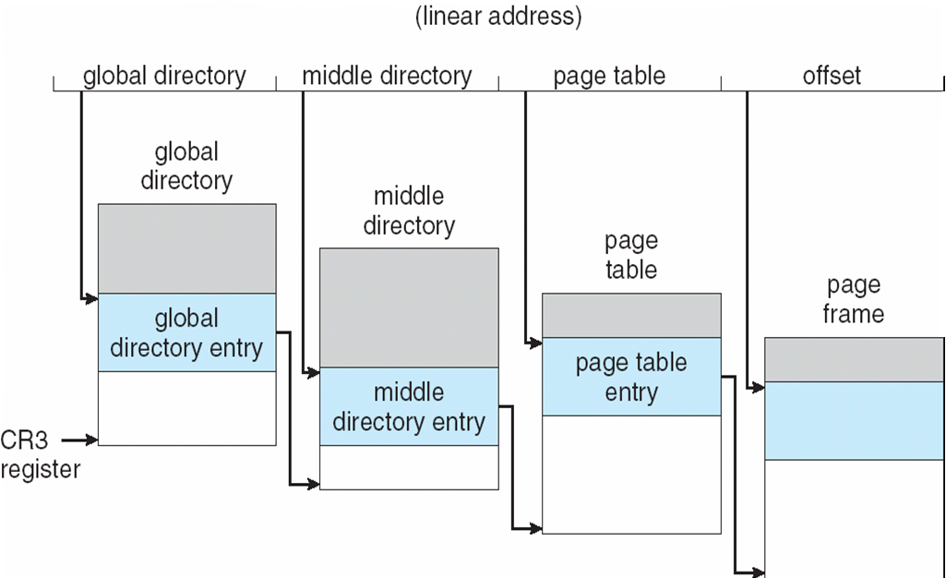
Three-level Paging in Linux

Slide 100
内存管理方案总结
单一连续区：每次只运行一个用户程序，用户程序独占内存，它总是被加载到同一个内存地址上
固定分区：把可分配的内存空间分割成若干个连续区域，每一区域称为分区。每个分区的大小可以相同也可以不同，分区大小固定不变，每个分区装一个且只能装一个进程
可变分区：根据进程的需求，把可分配的内存空间分割出一个分区，分配给该进程
页式：把用户程序地址空间划分成大小相等的部分，称为页。内存空间按页的大小划分为大小相等的区域，称为内存块（物理页面，页框，页帧）。以页为单位进行分配，逻辑上相邻的页，物理上不一定相邻
段式：用户程序地址空间按进程自身的逻辑关系划分为若干段，内存空间被动态的划分为若干个长度不相同的区域（可变分区）。以段为单位分配内存，每一段在内存中占据连续空间，各段之间可以不连续存放
段页式：结合了段式与页式。用户程序地址空间：段式；内存空间：页式；分配单位：页

Slide 101
Summary 1/4
Memory is central to the operation of a modern computer system and consists of a large array of bytes, each with its own address.
One way to allocate an address space to each process is through the use of base and limit registers. The base register holds the smallest legal physical memory address, and the limit specifies the size of the range.
Binding symbolic address references to actual physical addresses may occur during (1) compile, (2) load, or (3) execution time.
An address generated by the CPU is known as a logical address, which the memory management unit (MMU) translates to a physical address in memory.

Slide 102
Summary 2/4
One approach to allocating memory is to allocate partitions of contiguous memory of varying sizes. These partitions may be allocated based on three possible strategies: (1) first fit 首次适应, (2) best fit 最佳适应, and (3) worst fit 最差适应.
Modern operating systems use paging to manage memory. In this process, physical memory is divided into fixed-sized blocks called frames and logical memory into blocks of the same size called pages.
When paging is used, a logical address is divided into two parts: a page number and a page offset. The page number serves as an index into a per process page table that contains the frame in physical memory that holds the page. The offset is the specific location in the frame being referenced.

Slide 103
Summary 3/4
A translation look-aside buffer (TLB，转换表缓冲区，快表) is a hardware cache of the page table. Each TLB entry contains a page number and its corresponding frame.
Using a TLB in address translation for paging systems involves obtaining the page number from the logical address and checking if the frame for the page is in the TLB. If it is, the frame is obtained from the TLB. If the frame is not present in the TLB, it must be retrieved from the page table.
Hierarchical paging involves dividing a logical address into multiple parts, each referring to different levels of page tables. As addresses expand beyond 32 bits, the number of hierarchical levels may become large. Two strategies that address this problem are hashed page tables and inverted page tables.

Slide 104
Summary 4/4
Swapping allows the system to move pages belonging to a process to disk to increase the degree of multiprogramming.
The Intel 32-bit architecture has two levels of page tables and supports either 4-KB or 4-MB page sizes. This architecture also supports page address extension, which allows 32-bit processors to access a physical address space larger than 4 GB. The x86-64 architectures are 64-bit architectures that use hierarchical paging.

Slide 105
End of Chapter 8: Main Memory

